Slide 1
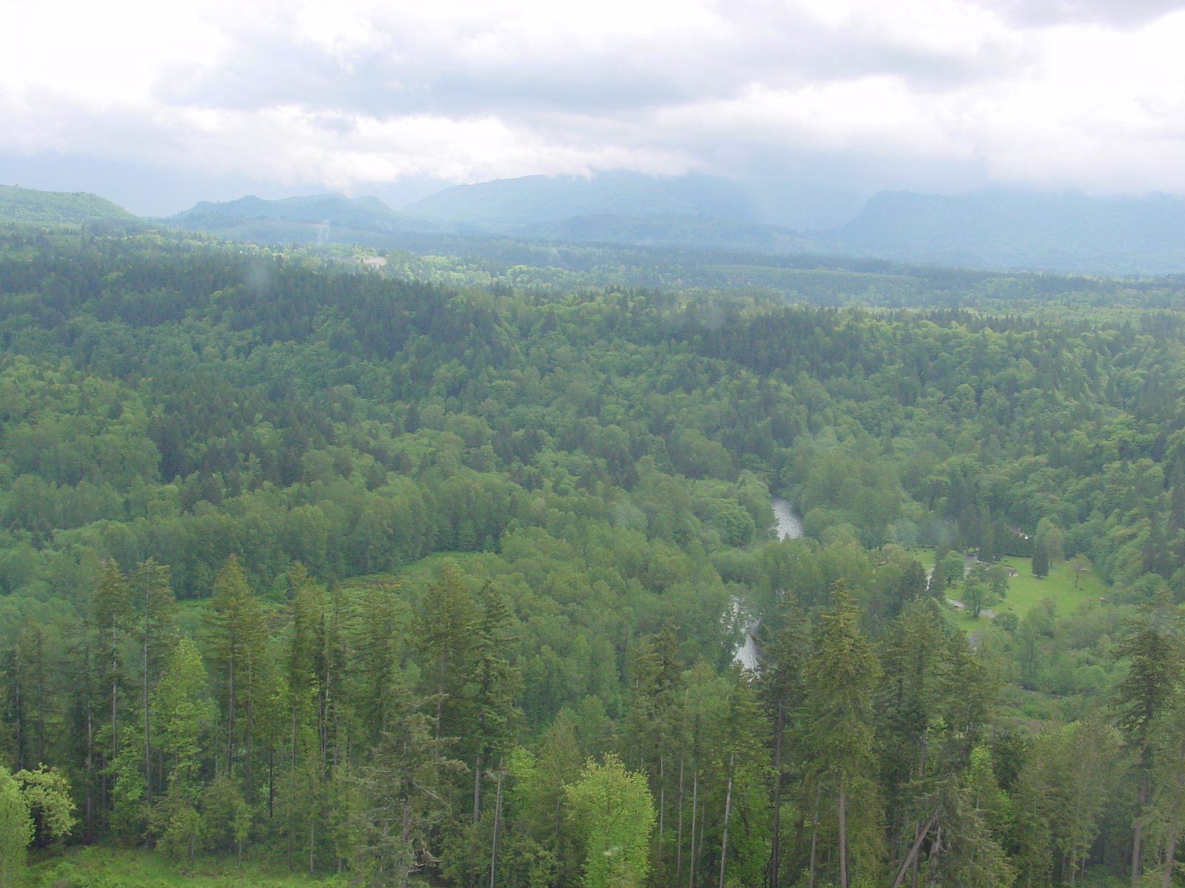
WRIA 9 Temperature TMDLs and Riparian Restoration “Rules of Thumb” For Temperature Management
Curtis DeGasperi
King County Department of Natural Resources and Parks
October 21, 2015
PHOTO: Green River near Flaming Geyser State Park looking towards Cascade crest
- May 16, 2001

Slide 2
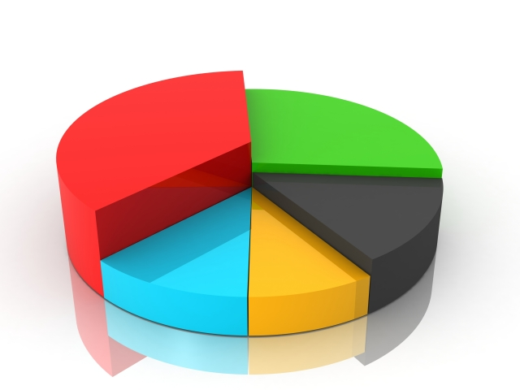
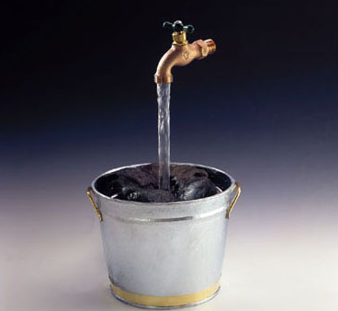
What is a TMDL?
Total Maximum Daily Load
Calculation - Max pollutant that a waterbody can receive and still meet water quality standards.
= Loading Capacity

Slide 3
What is a TMDL?
Plan – to improve WQ.
  Identify sources
  Divide the Loading Capacity ‘Pie’
Point sources (NPDES)
  Wasteload allocations (WLAs)
Non-point (BMPs)
  Load Allocations (LAs)

Slide 4

TMDL Process
WQ data collection
Data assessment
WQ Improvement Report and submit to EPA for approval
Implement BMPs and adjust NPDES permits
Effectiveness monitoring

Slide 5
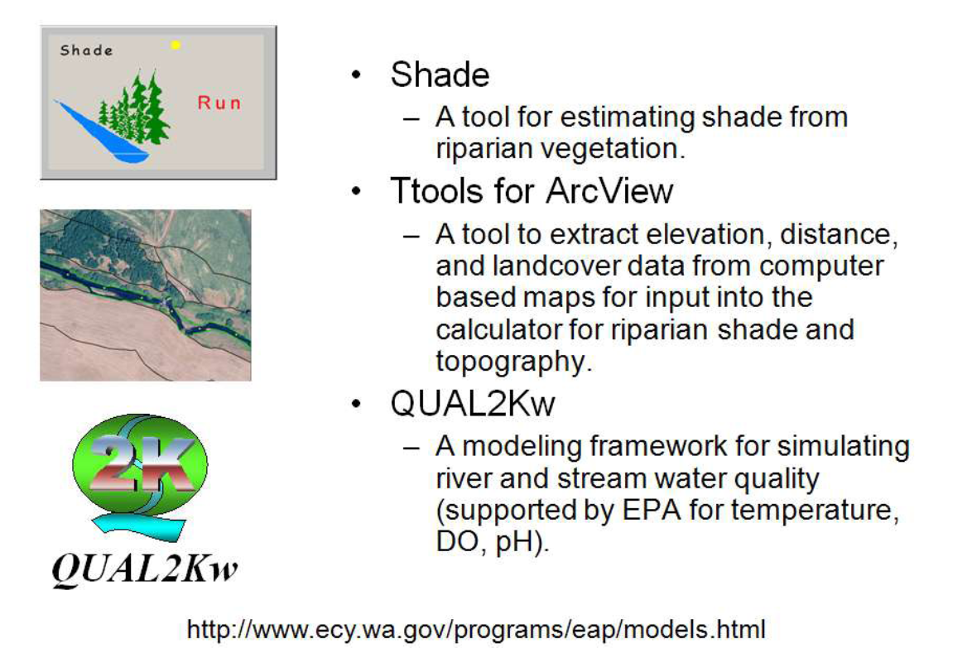
Ecology Modeling Tools

Slide 6
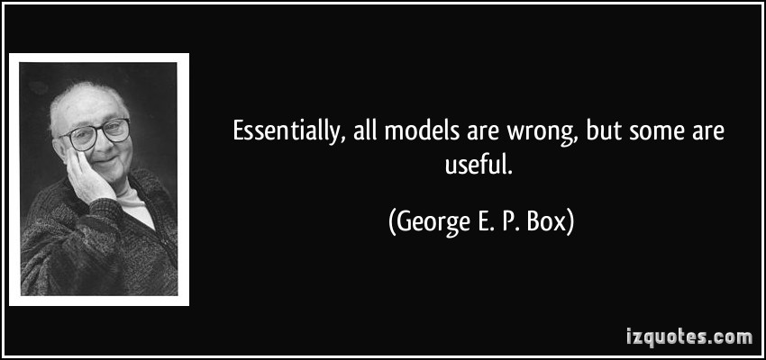
About Models

Slide 7
WRIA 9 Temperature TMDLs
Green River below Howard Hanson Dam
  Completed 2011
Newaukum Creek
  Completed 2011
Soos Creek (Big/Little Soos, Covington, Jenkins)
  Ongoing
See Ecology web sites for more information

Slide 8
Potential Causes of Stream Temperature Alteration
Loss of riparian habitat: solar radiation + heat
Channel modification (widening, narrowing, deepening, shallowing)
Loss of lateral connectivity or hyporheic exchange
Flow changes due to surface and ground water withdrawals and flow management activities

Slide 9
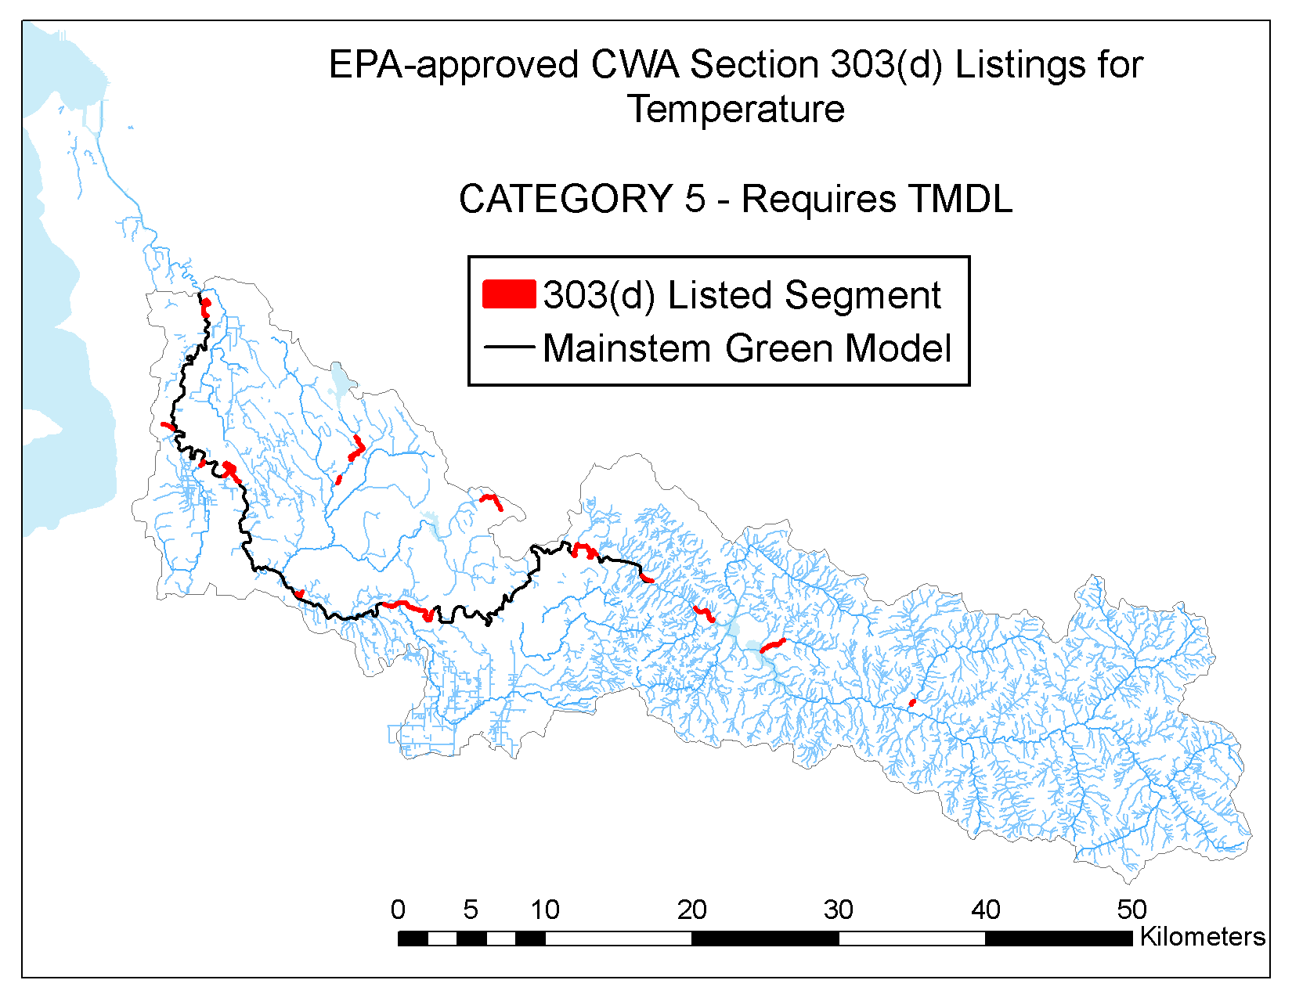
Temperature
_{Temperature WQ Std = 16}º_{C}
_{303(d) listings}
_{TMDL Study}
_{Field Monitoring}
_{Use Data to Develop Model}
Use Model Predictions to Guide Actions

Slide 10
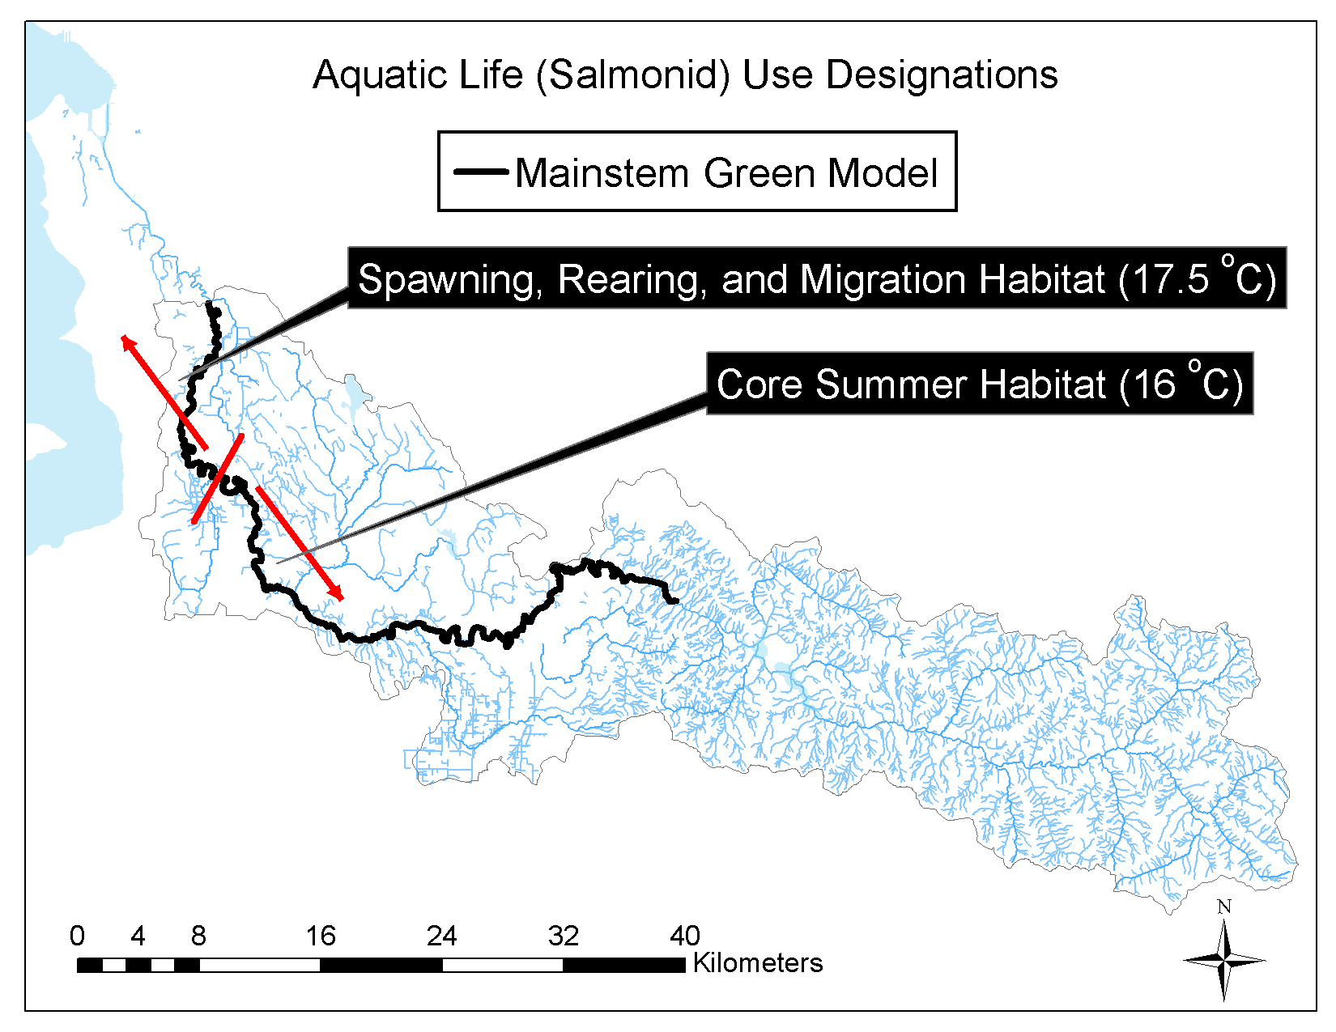
Temperature Criteria

Slide 11
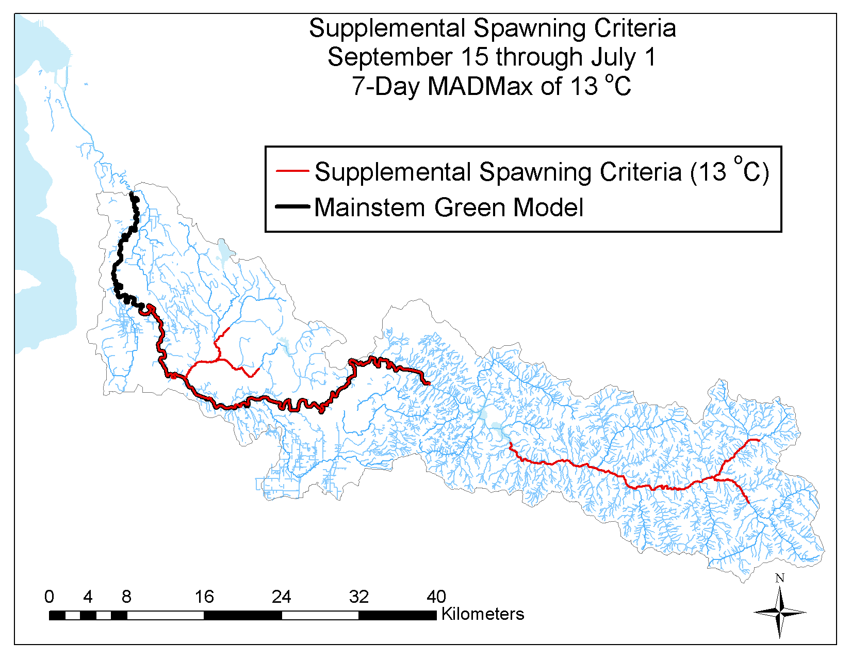
Supplemental Spawning and Incubation Criteria

Slide 12
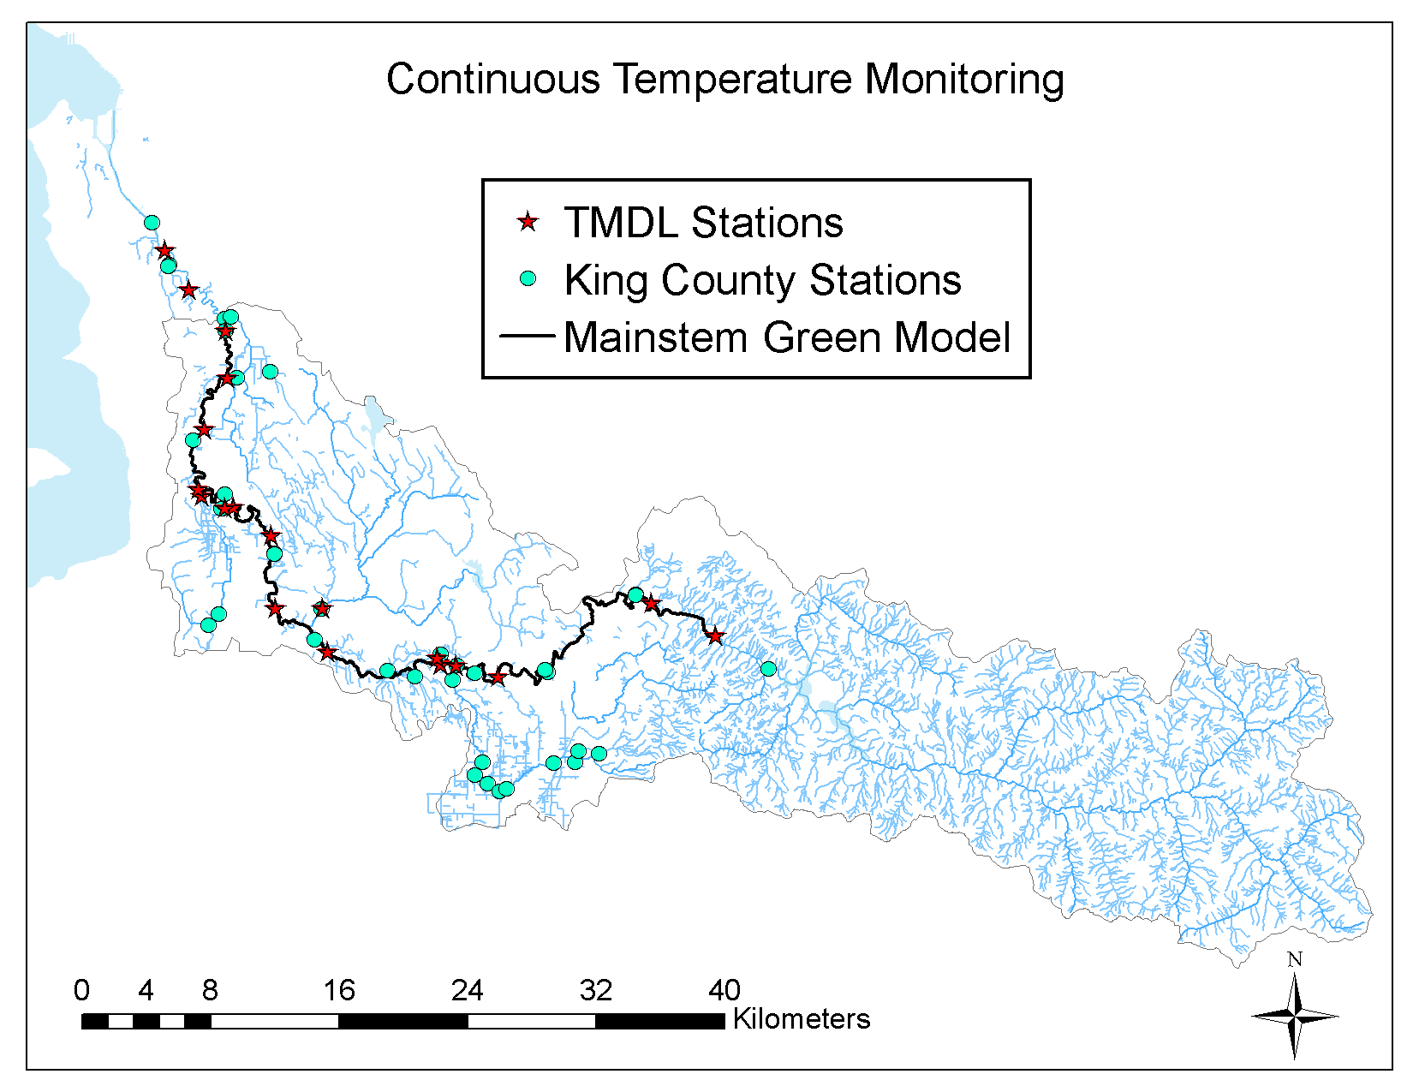
Continuous Temperature Data

Slide 13
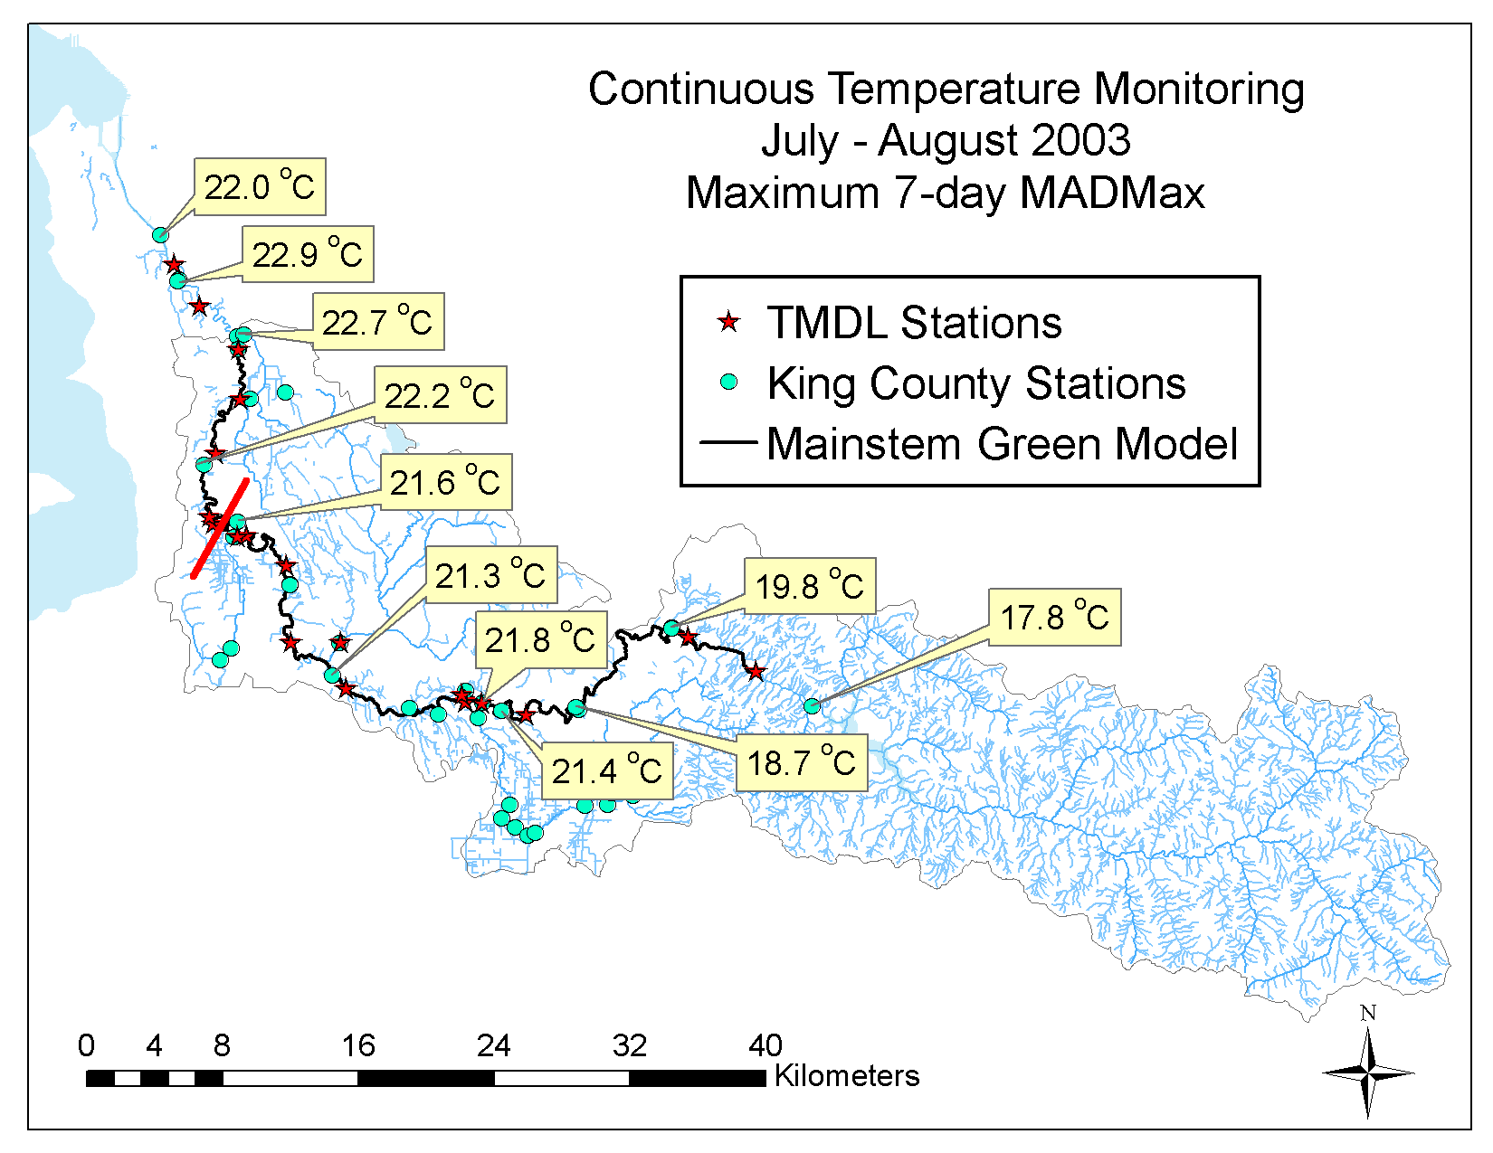
Continuous Temperature Data

Slide 14
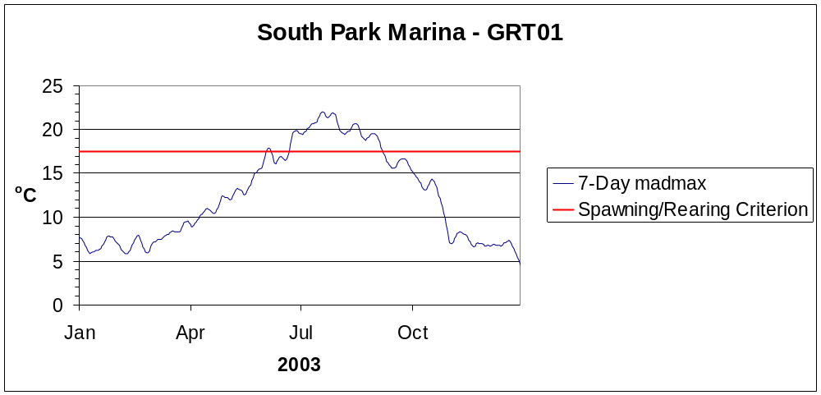
King County 2003
Continuous Temperature Data

Slide 15
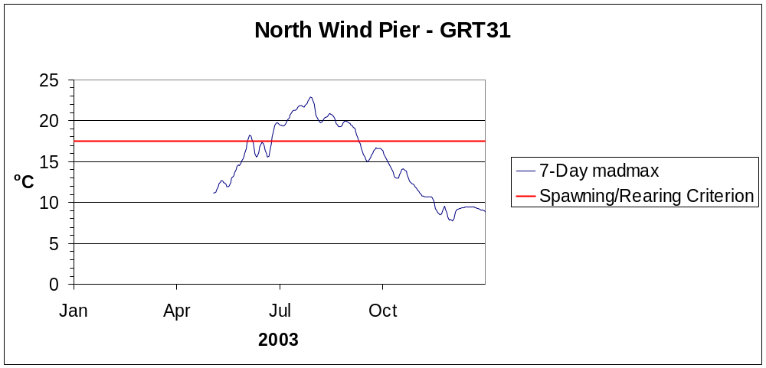
King County 2003
Continuous Temperature Data

Slide 16
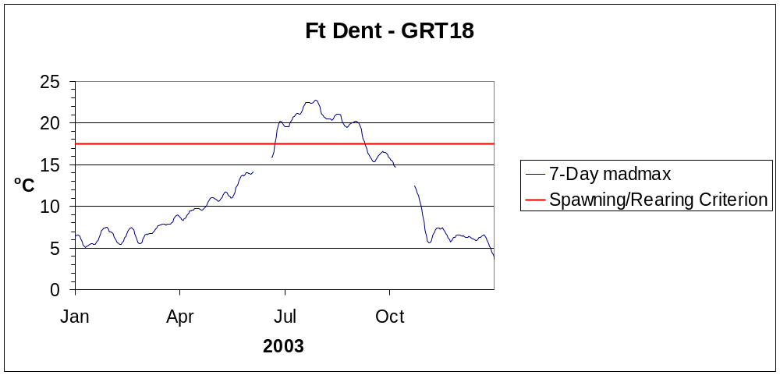
King County 2003
Continuous Temperature Data

Slide 17
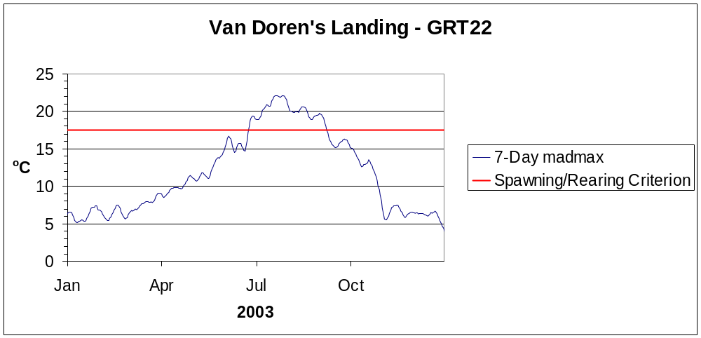
King County 2003
Continuous Temperature Data

Slide 18
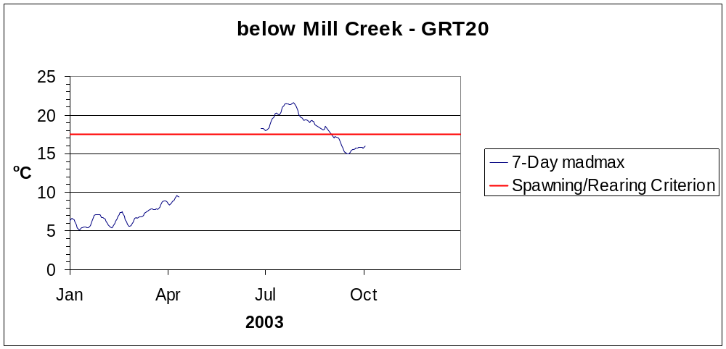
King County 2003
Continuous Temperature Data

Slide 19
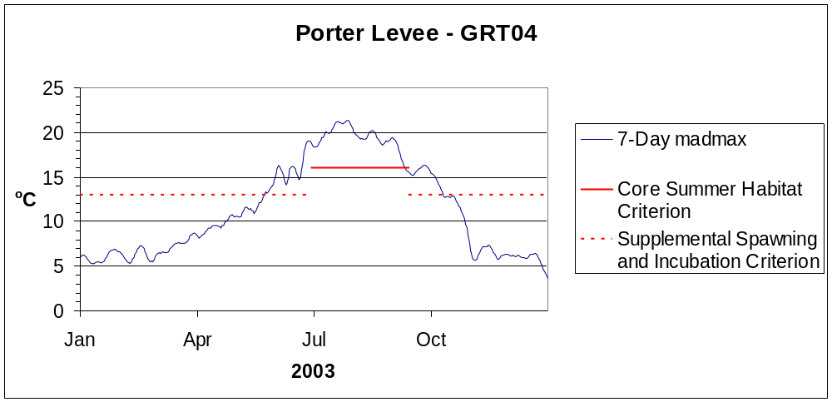
King County 2003
Continuous Temperature Data

Slide 20
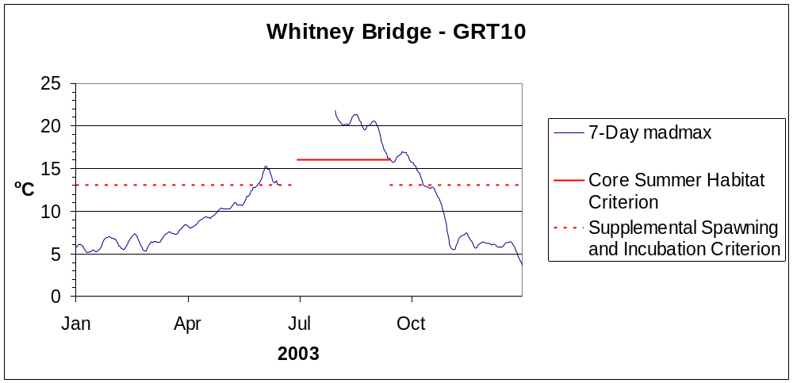
King County 2003
Continuous Temperature Data

Slide 21
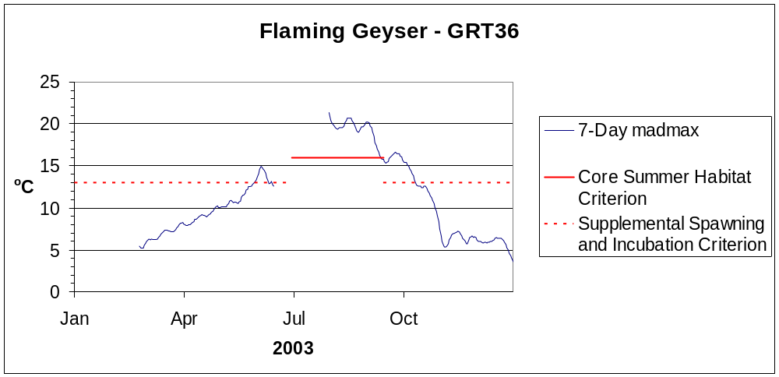
King County 2003
Continuous Temperature Data

Slide 22
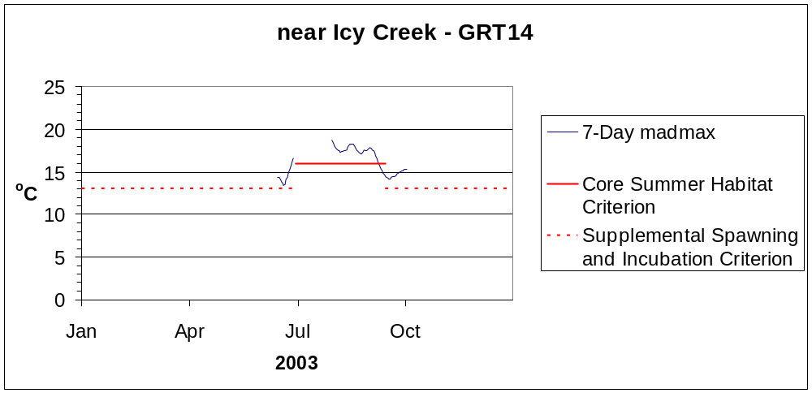
King County 2003
Continuous Temperature Data

Slide 23
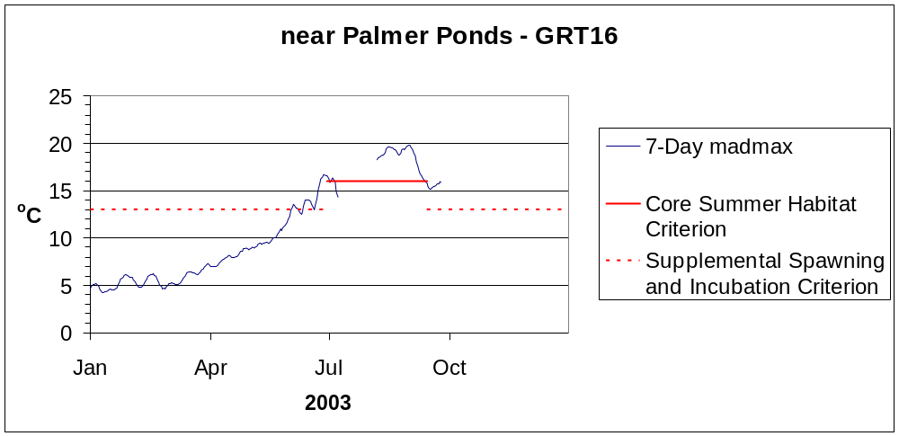
King County 2003
Continuous Temperature Data

Slide 24
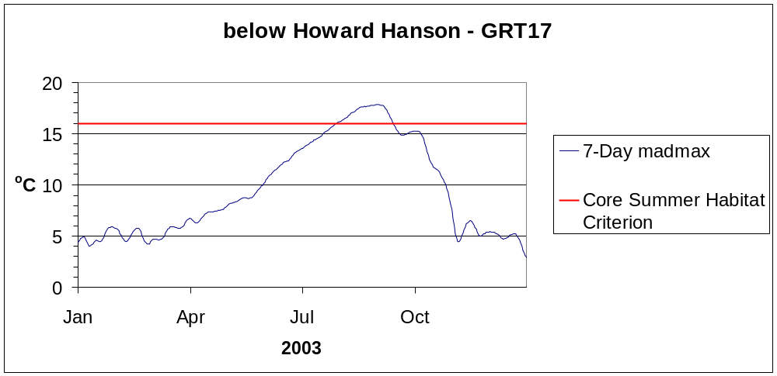
King County 2003
Continuous Temperature Data

Slide 25
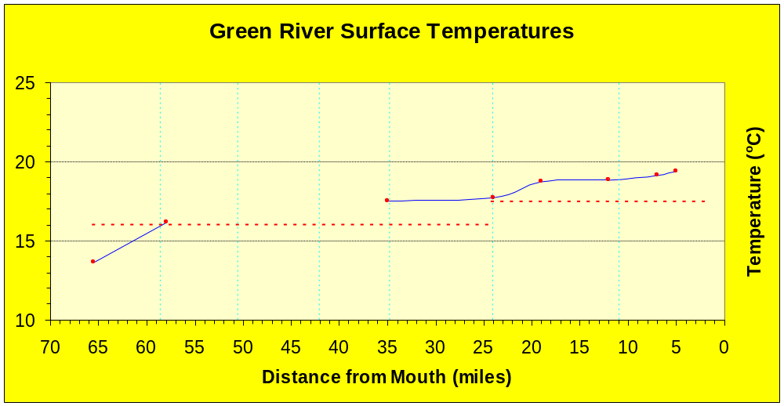
Green River
Summer 2003

Slide 26
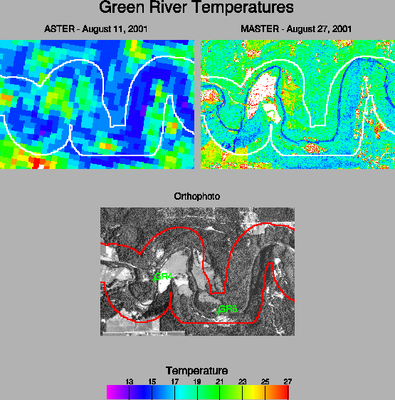
MASTER-ASTER TIR STUDY
UW Civil Engineering
Principal Investigator: Steve Burgess

Slide 27
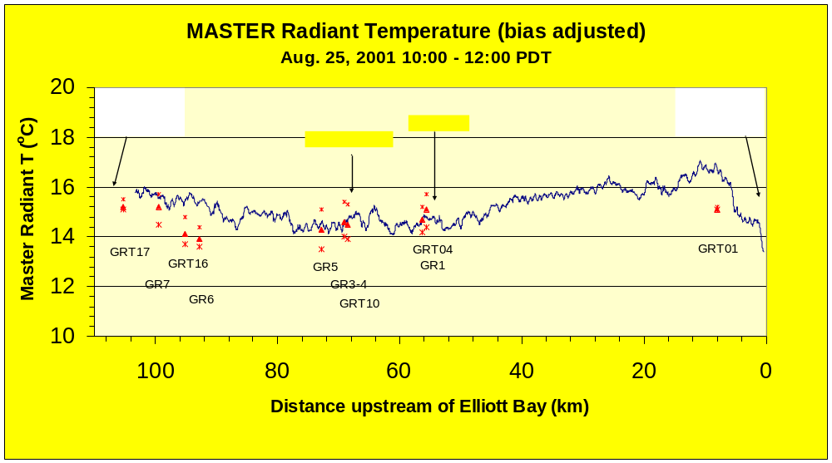
MASTER-ASTER TIR STUDY

Slide 28
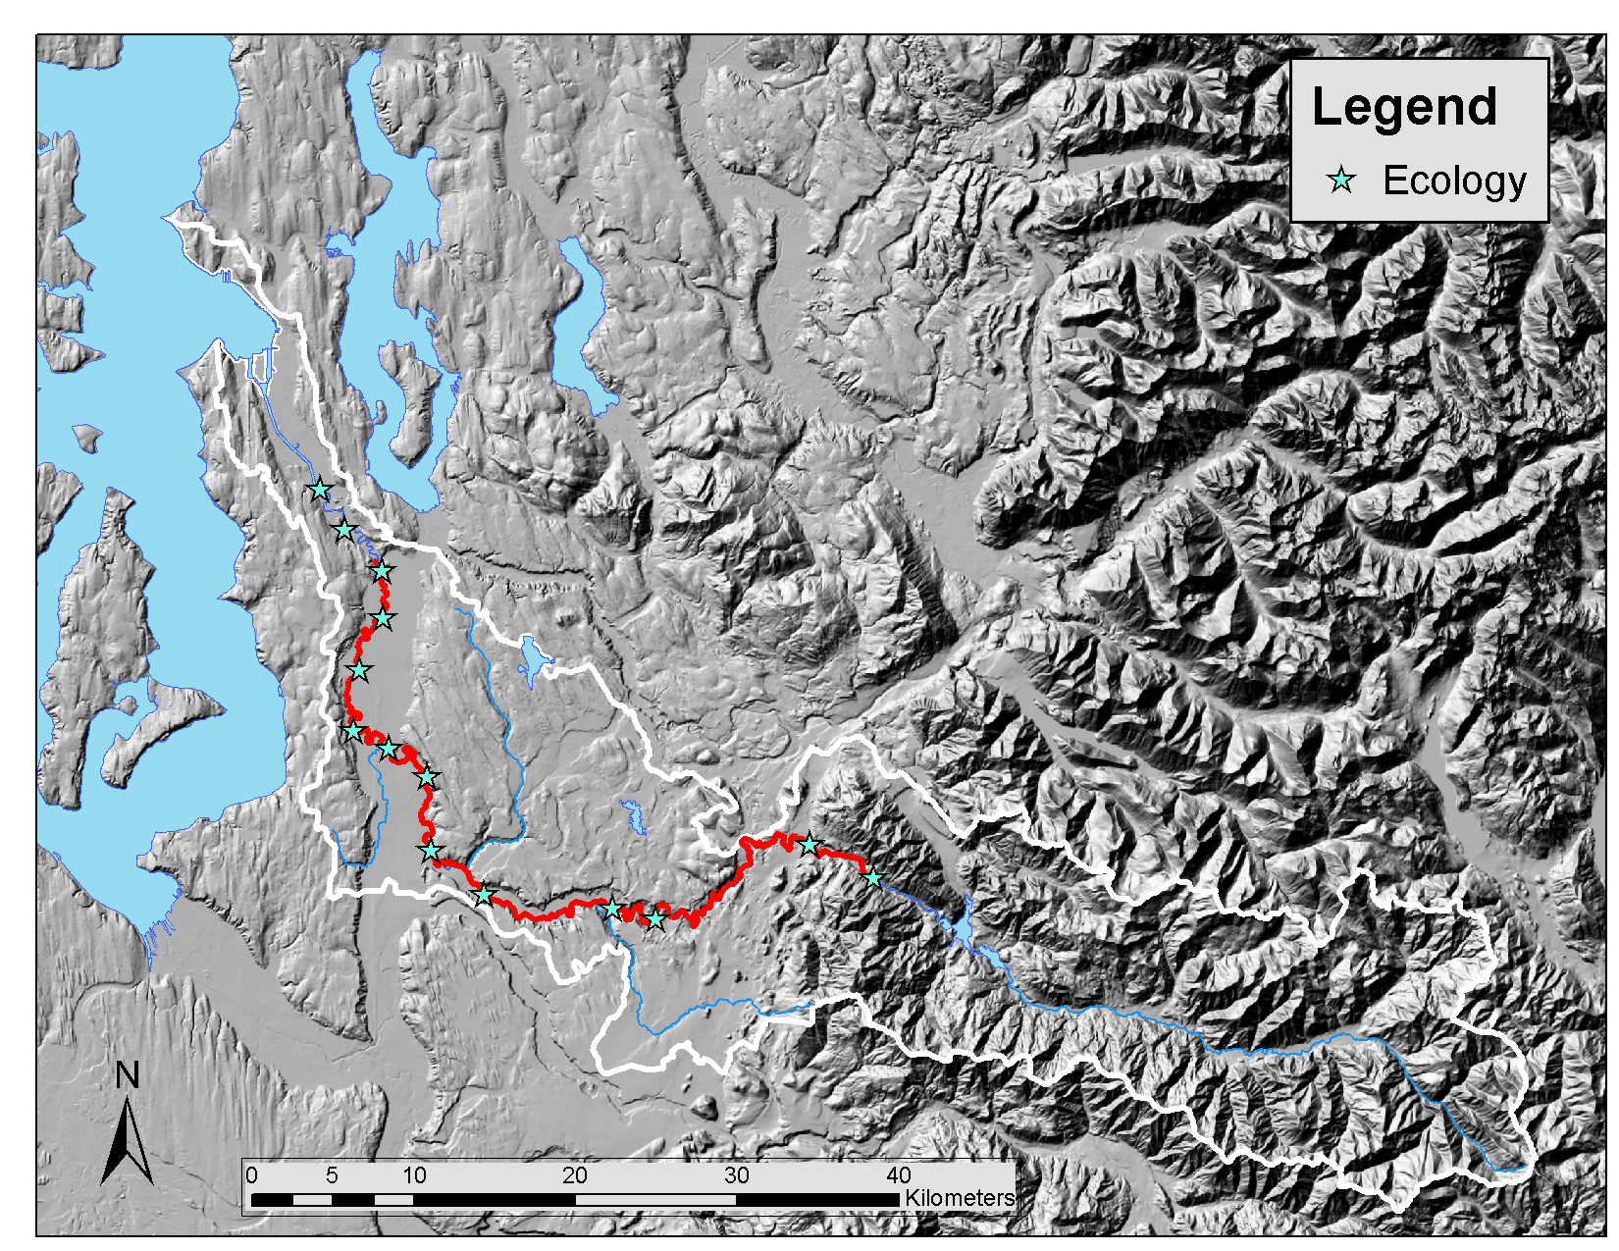
Summer 2006 Field
Monitoring
Continuous temperature (air, water, relative humidity)
Continuous dissolved oxygen, pH & conductivity
Hemispherical photographs
Synoptic productivity: nutrients, periphyton, & flows
No travel time dye studies

Slide 29
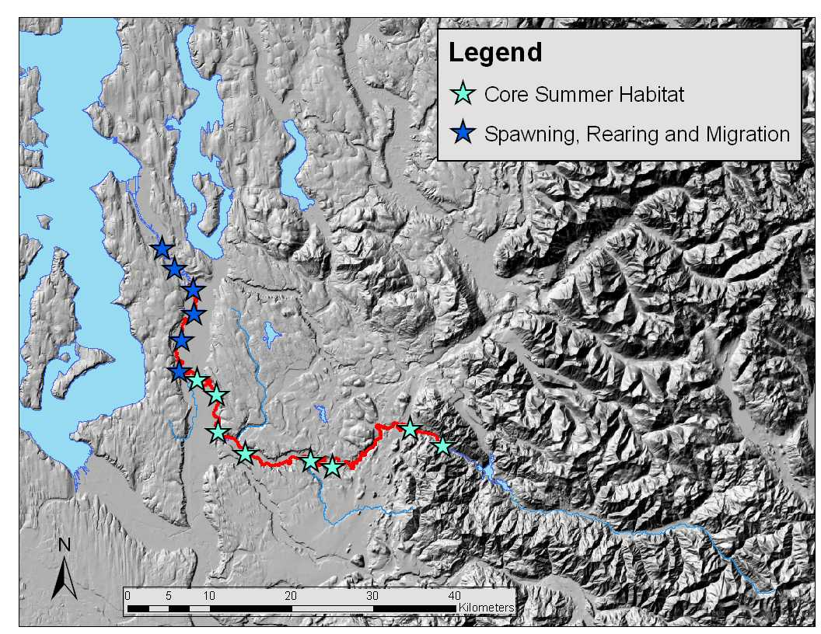
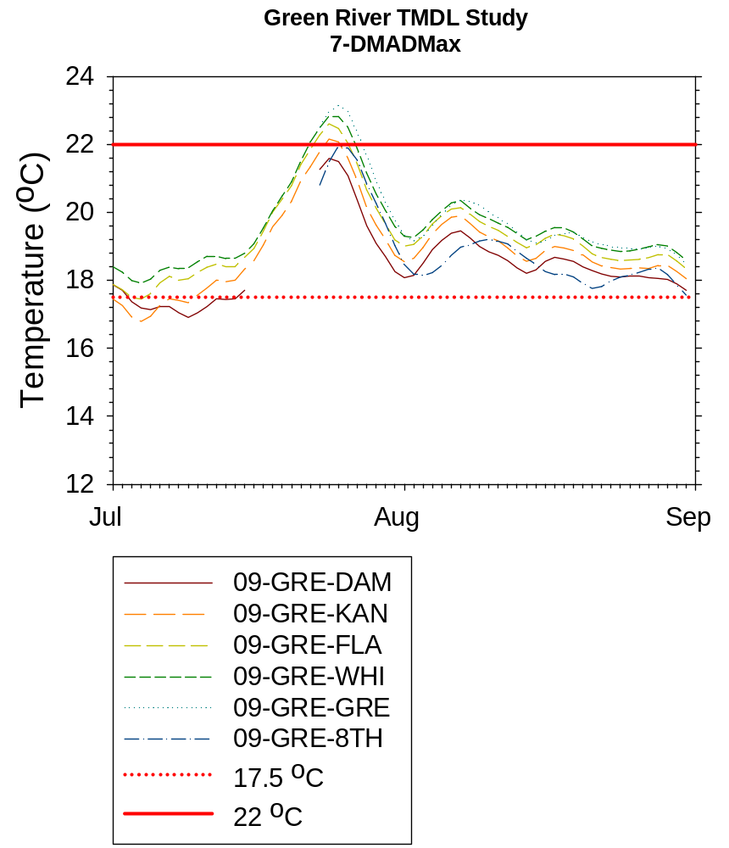
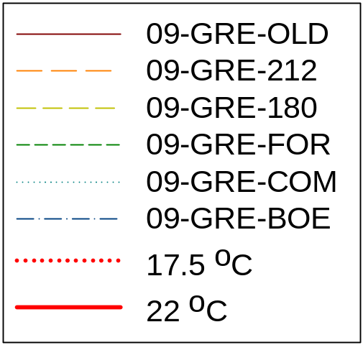
Green River
Temperature Data

Slide 30
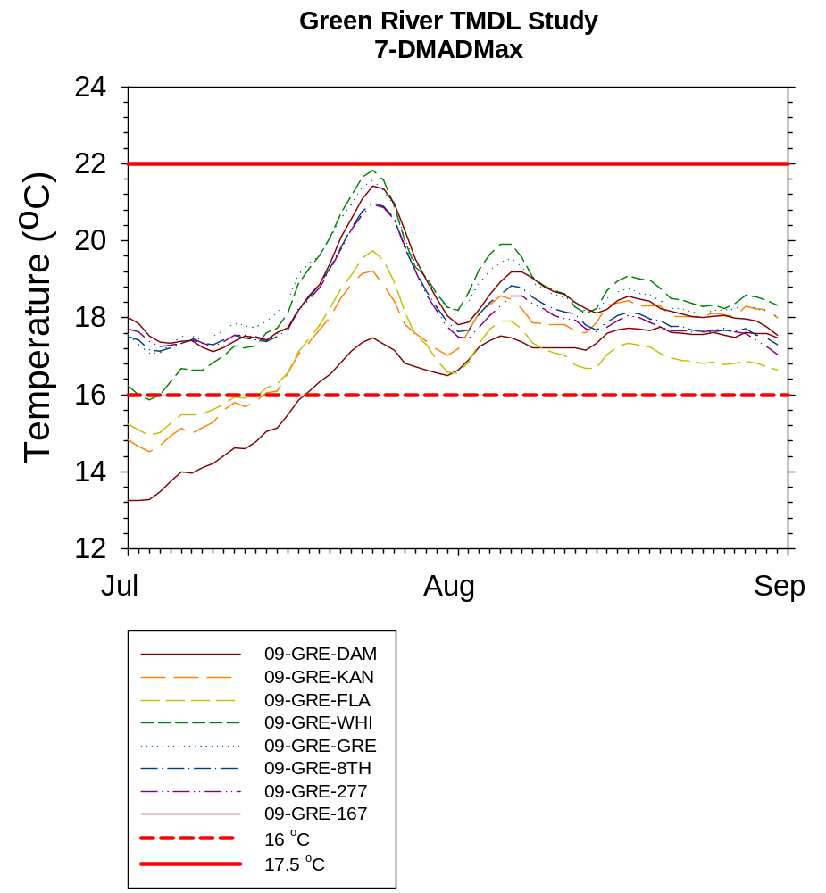
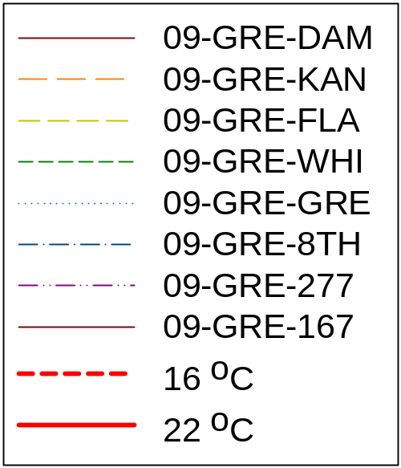
Green River
Temperature Data

Slide 31
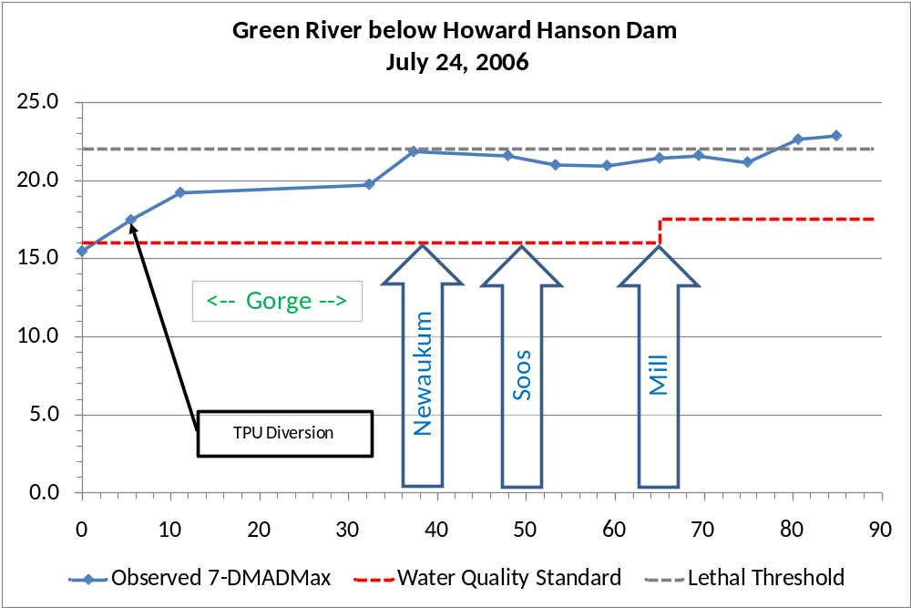
Green River Temperature Data

Slide 32
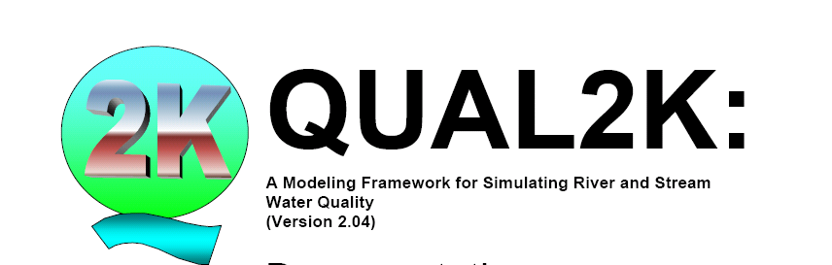
QUAL2Kw
One-dimensional: vertically and laterally mixed
Steady-state: non-uniform, steady flow
Diel water-quality kinetics
Point and non-point inputs/withdrawals simulated
Effect of topographic and riparian shade included

Slide 33
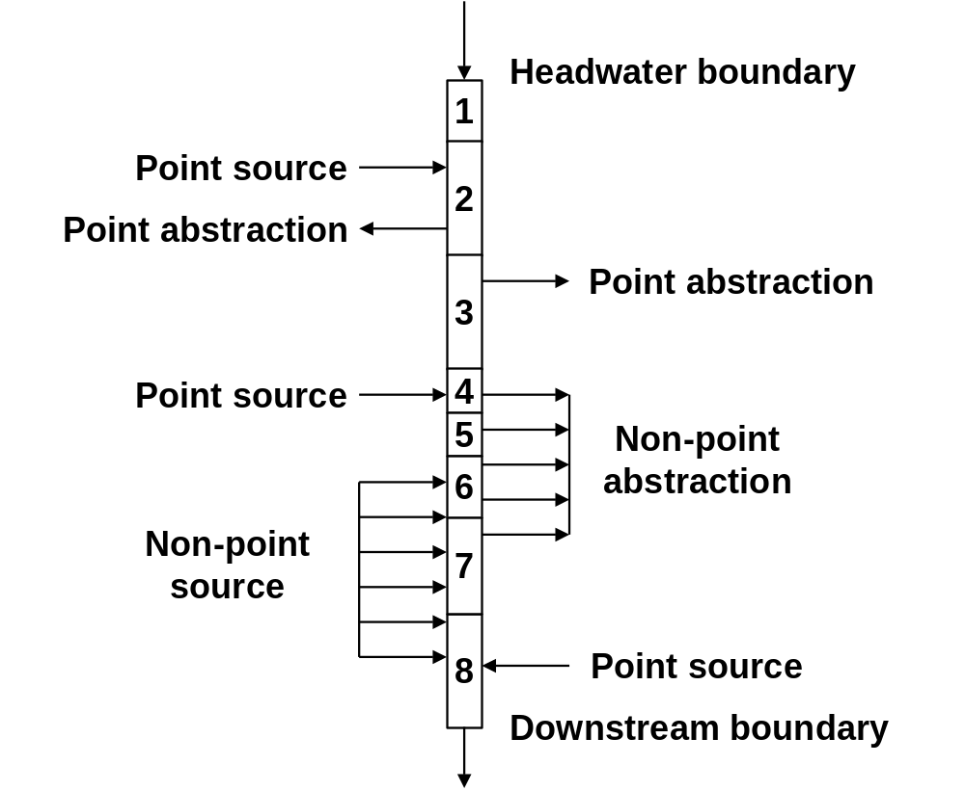
Modeling Temperature
QUAL2Kw: a one-dimensional water quality model
  Headwater/Boundary Conditions:
  Flow
  Temperature
  Channel geometry

Slide 34
Modeling Temperature
cloud cover, air temperature, relative humidity
_{CLIMATE}
vegetation height, density and overhang
_{SOLAR RADIATION}
_{SHADE}
_{channel width}
_{point + non-point}
_{inflows}
_{TRAVEL TIME}
_{+ VELOCITY}
_{point + non-point}
_{outflows}
_{slope}
_{depth}
Hyporheic and thermal exchanges

Slide 35
Model Development
Model geometry (slope/width)
Shade
Hydraulics (flow/depth/velocity)
Temperature

Slide 36
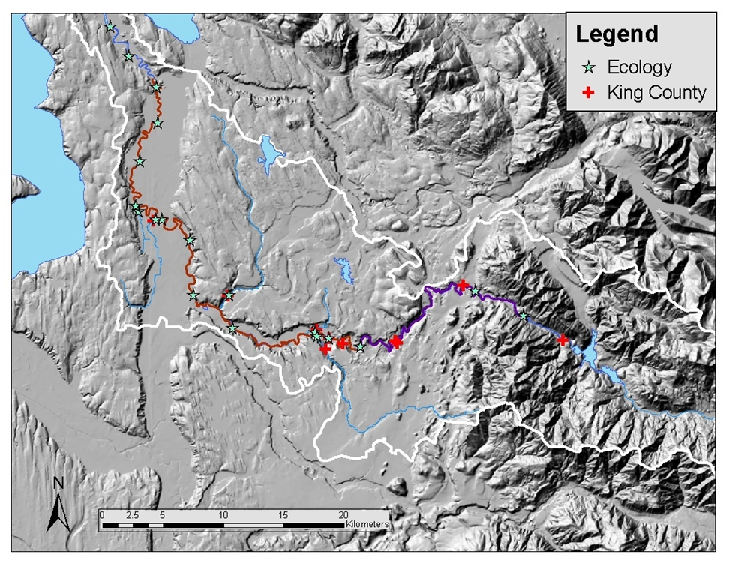
Data Collection
July-September 2006
Continuous Temperature Sensors

Slide 37
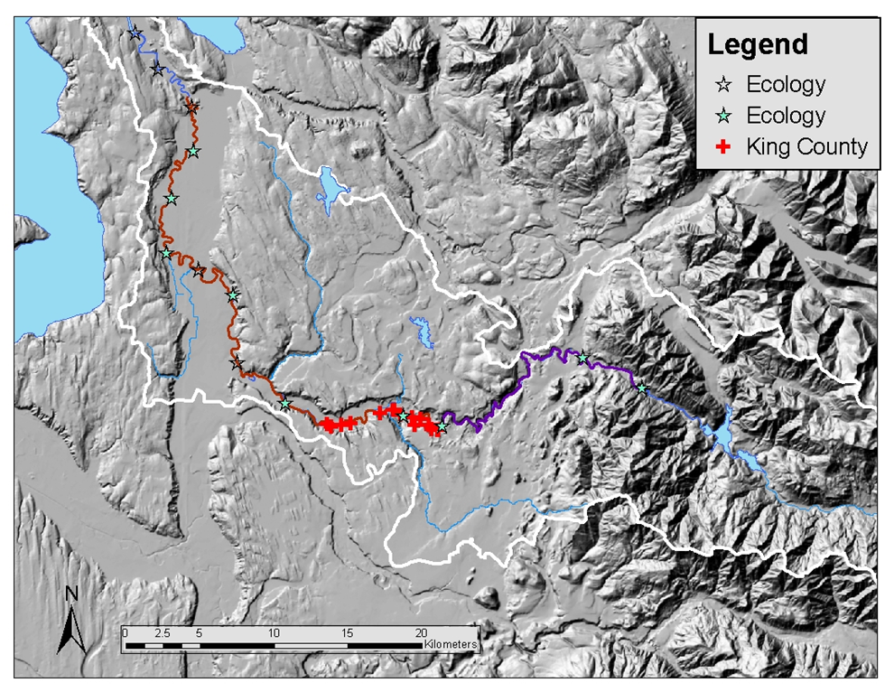
Data Collection
July-September 2006
Fisheye Photos

Slide 38
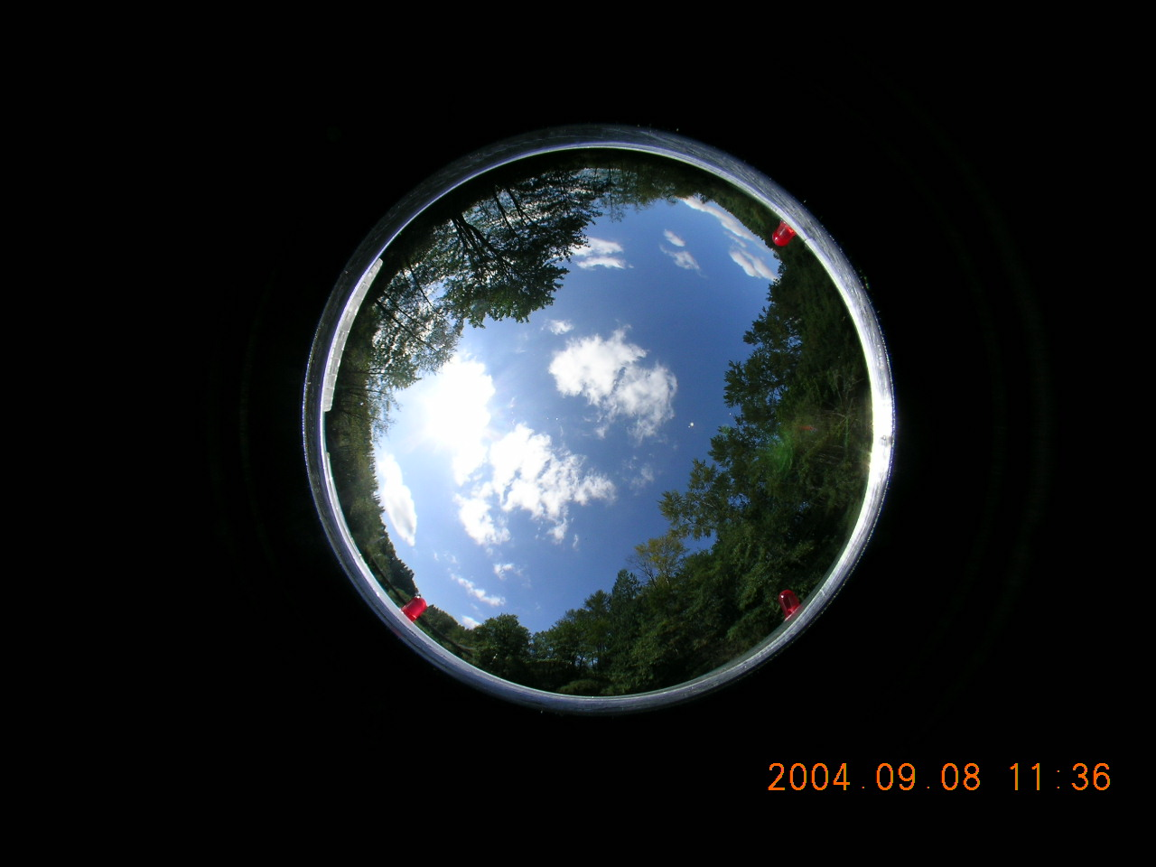
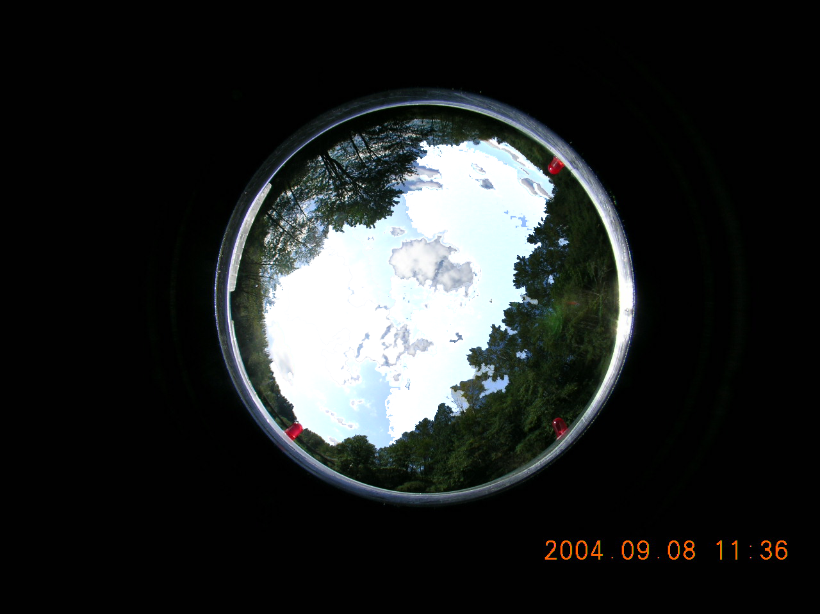
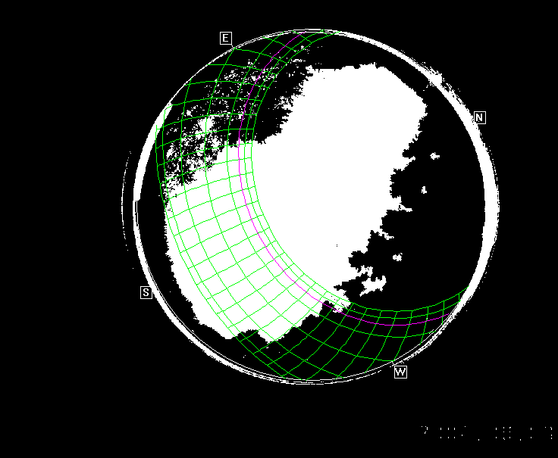

EFFECTIVE SHADE

Slide 39
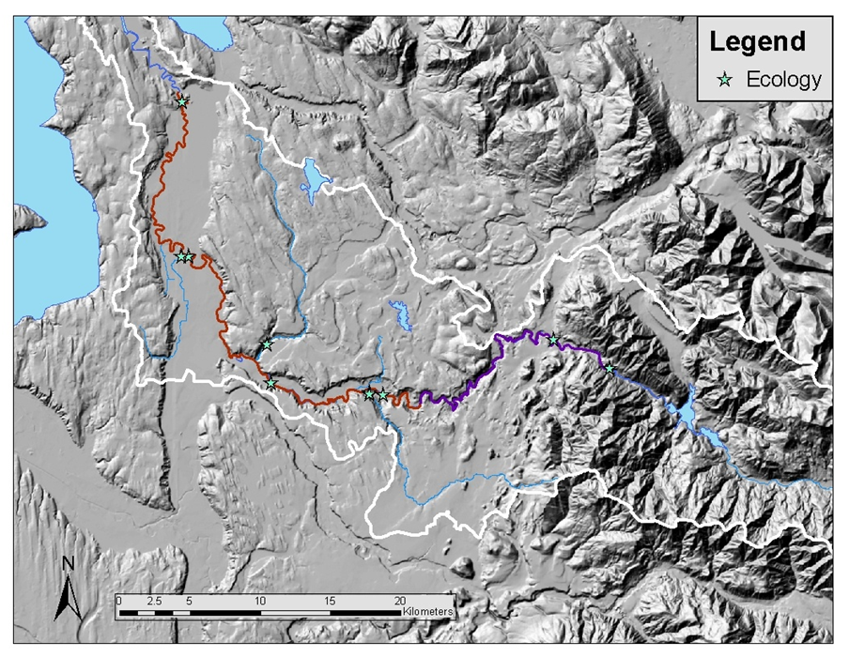
Data Collection
Synoptic Water Quality Study
August 1-2, 2006

Slide 40
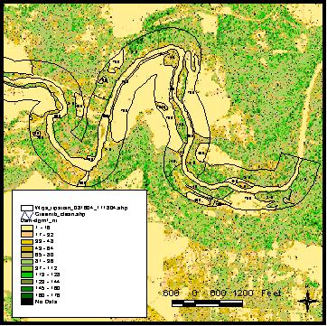
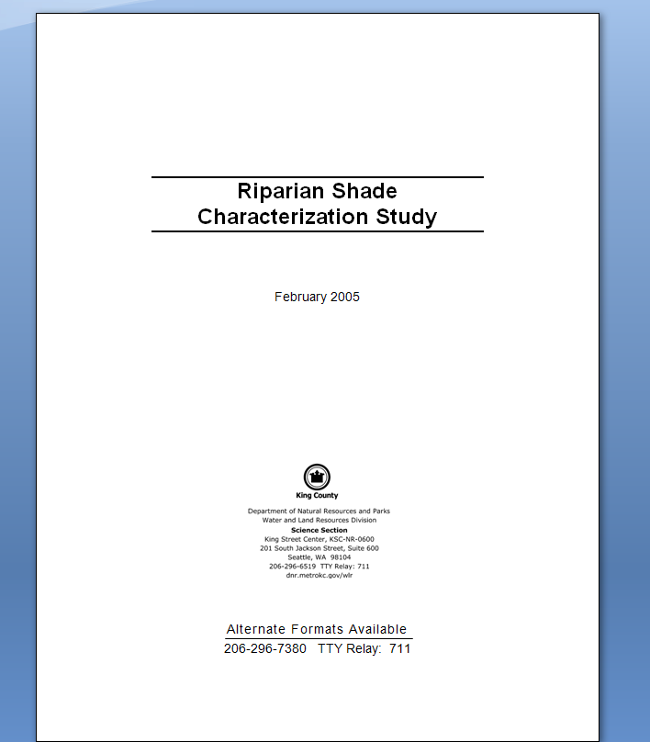
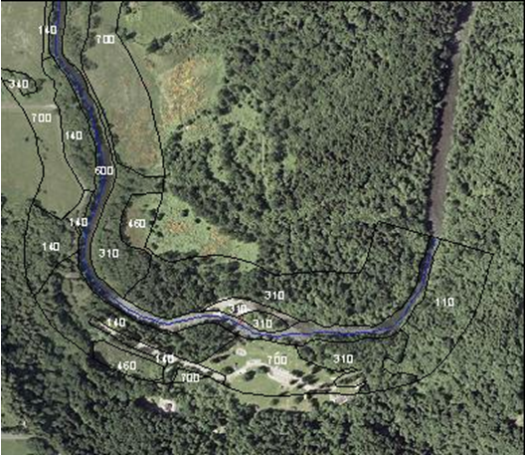
Riparian Shade Analysis
http://www.kingcounty.gov/environment/wlr/sections-programs/science-section/riparian-shade-characterization-study.aspx

Slide 41
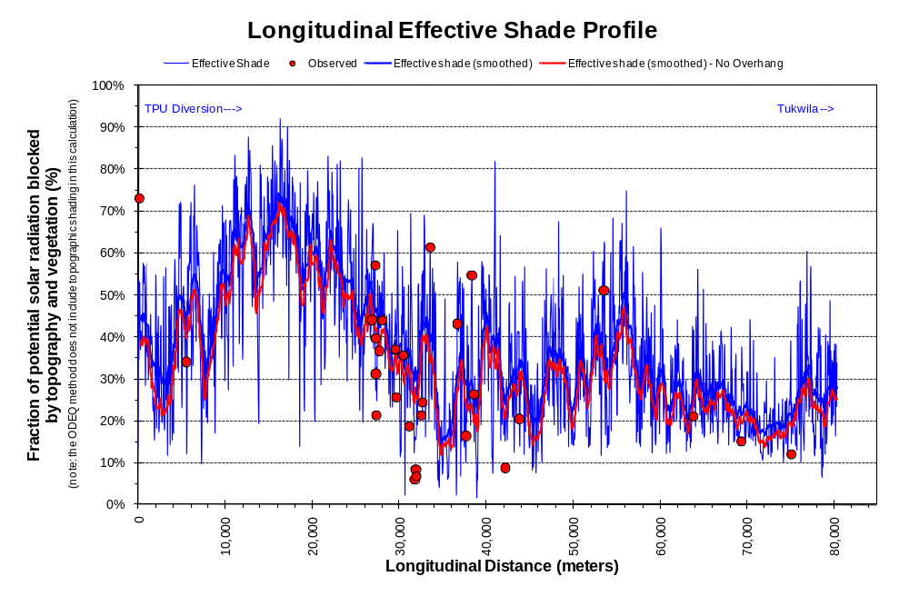
Current Shade Model Results
Effective Shade (%)
Shade modeled every 50 meters along the river for August 2, 2006

Slide 42
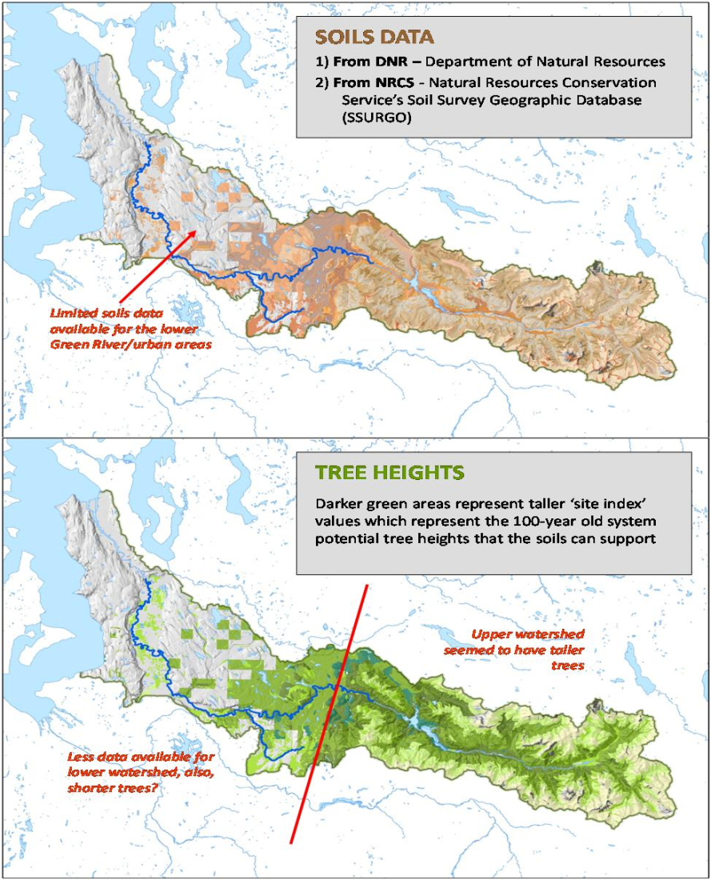
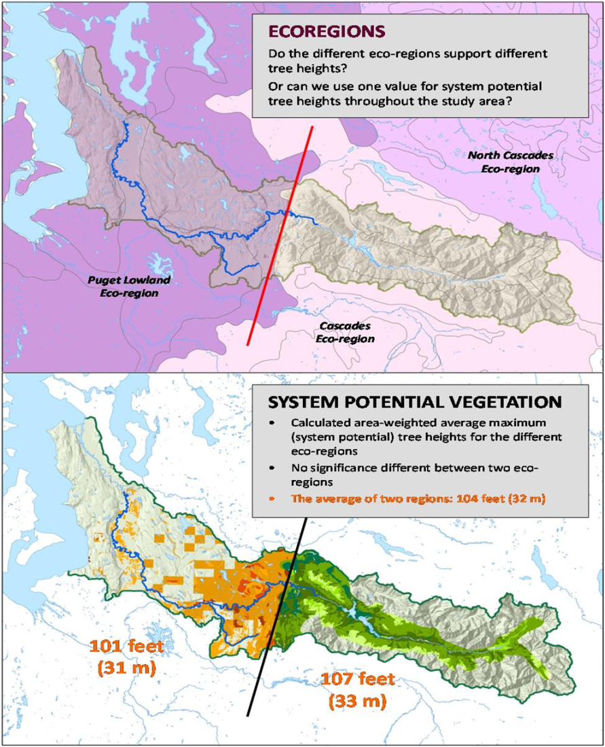
System Potential Shade
System Potential Tree Height Estimated to be 32 m

Slide 43
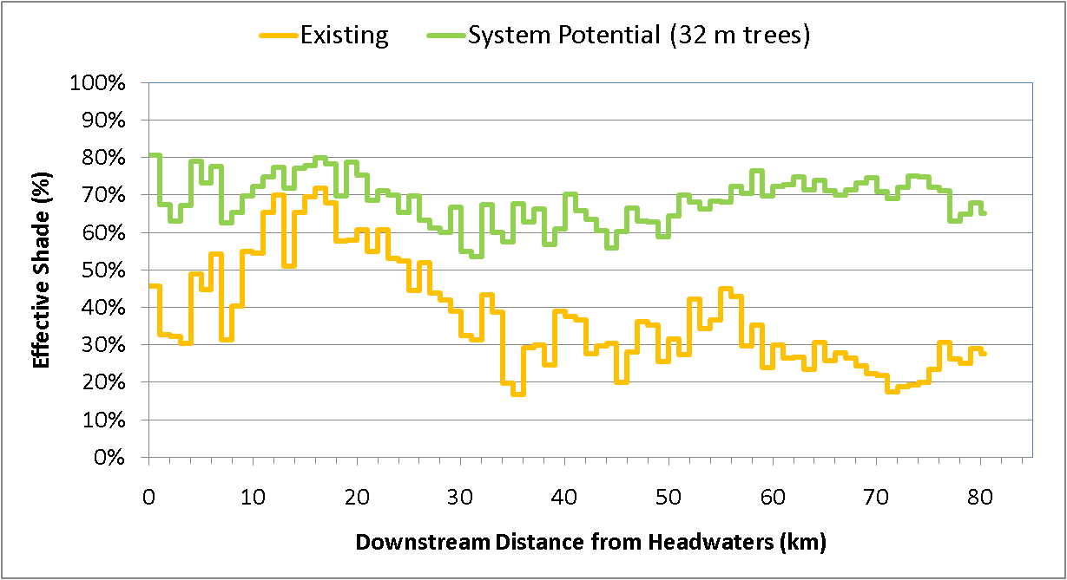
Current and System Potential Shade
<- Gorge ->
Newaukum
Soos
Mill

Slide 44
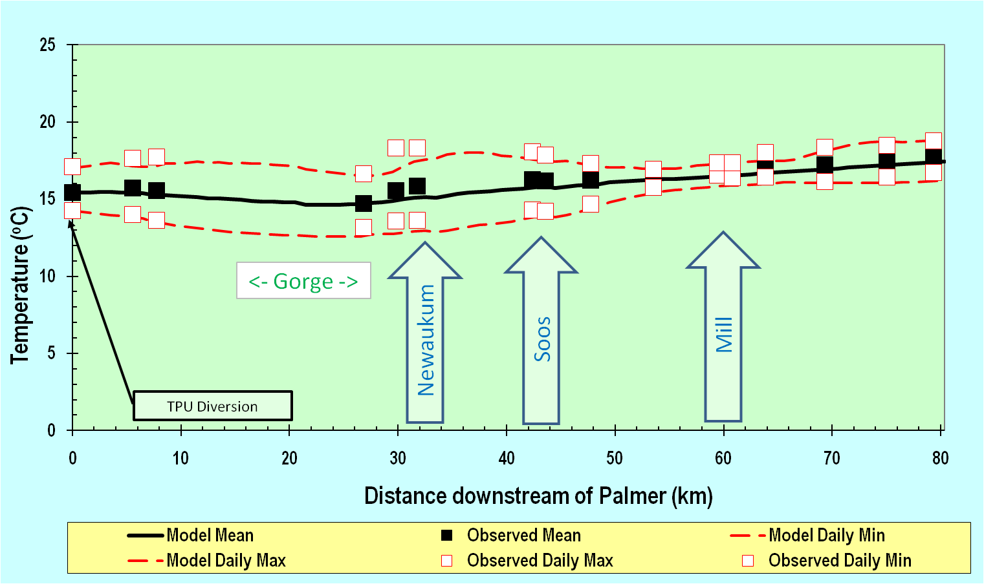
Temperature Model Calibration

Slide 45
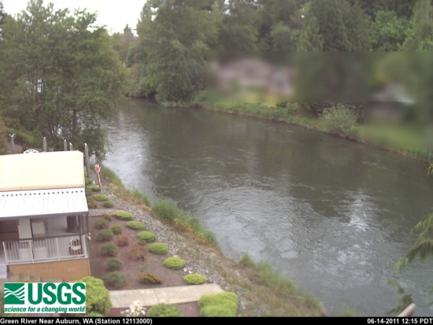
Critical Condition or 7Q10 Scenario
7Q10 Flow for Soos and Newaukum based on gauge data (21 and 12 cfs, respectively)
Other tributary flows scaled from above
7Q10 weather based on long-term Sea-Tac data
FDWR flow of 225 cfs at Auburn
Head boundary (Palmer) flow 119 cfs

Slide 46
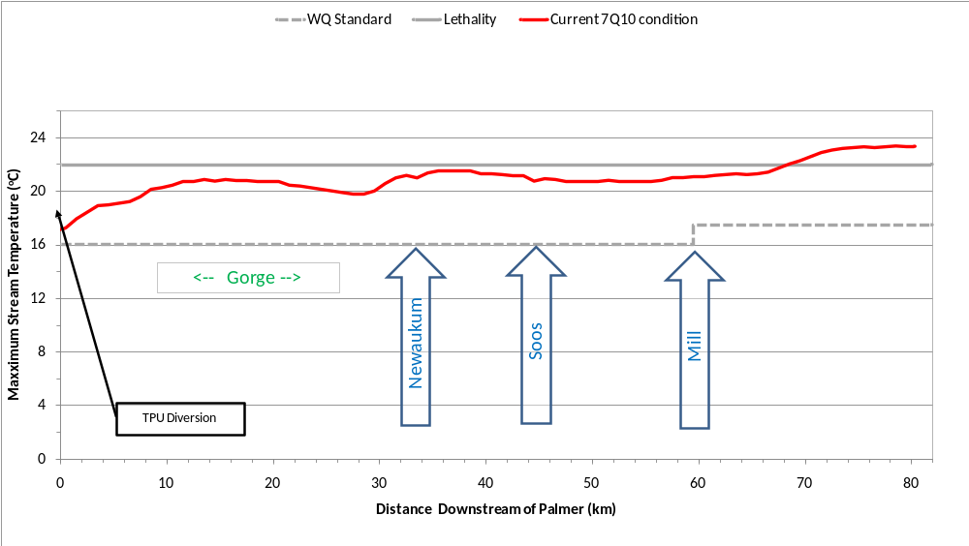
Results!
Current Riparian Condition

Slide 47
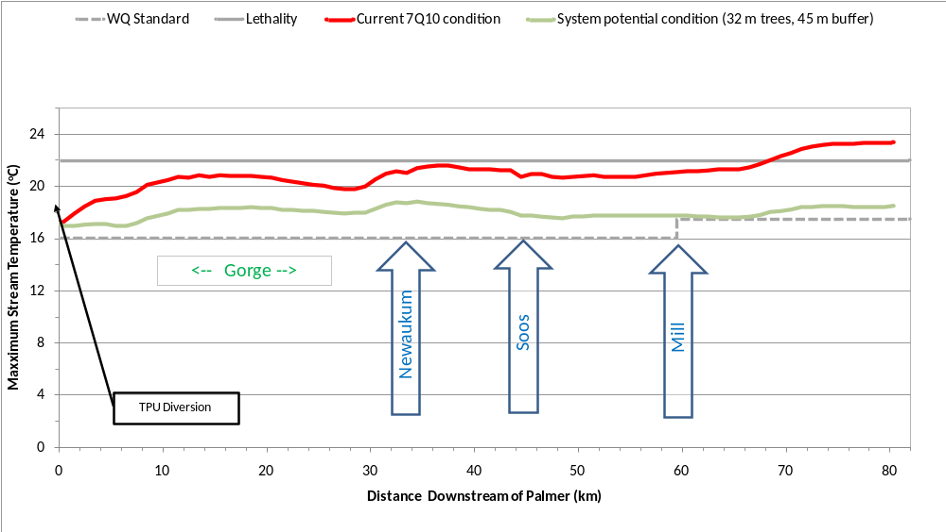
Results!
Max = 9 ºF (5 ºC )
System Potential Riparian Condition

Slide 48

Shade Deficit

Slide 49

Soos Creek

Slide 50

System Potential Shade

Slide 51

Heat Load

Slide 52

Temperature Scenarios

Slide 53

Temperature Scenarios

Slide 54
Newaukum Creek

Slide 55

System Potential Shade

Slide 56

Water Temperature Cabliration
Calibration for
August 2, 2006
RMSE = 0.42 ºC

Slide 57

Temperature Scenarios

Slide 58

Temperature Scenarios

Slide 59

Rules of Thumb-from Riparian Restoration Research
Restore lower order streams before higher order streams

Slide 60
Rules of Thumb from Riparian Restoration Research
Work in areas with no vegetation before seeking to enhance areas with lower density of vegetation
Preferentially revegetate sites that have the highest solar radiation aspects
Restore reaches where soil properties are most favorable for successful establishment

Slide 61
Rules of Thumb-from Riparian Restoration Research
Actively managing plantings may provide more benefit more quickly than passive approaches
Restoration is most appropriately undertaken at the scale of entire subcatchments (~1000 m reach lengths)
Vegetation density and height is as important as buffer width

Slide 62

Rules of Thumb-from Riparian Restoration Research
Preferentially restore southern aspects, but don’t ignore east or west stream aspects

Slide 63

Rules of Thumb-from Riparian Restoration Research
Shade from stream overhang can be important in small streams

Slide 64


Slide 65


Slide 66


Slide 67


Relevant Examples?
http://www.cleanwaterservices.org

Slide 68
RipStream Monitoring Questions
(Riparian Function and Stream Temperature)
Are riparian rules effective in meeting water quality standards?
Are riparian rules effective in maintaining large wood recruitment to streams, downed wood in riparian area, and shade?
What are the trends in riparian area regeneration?
What are the trends in overstory and understory riparian characteristics and how do they, along with channel and valley characteristics, relate to stream temperature and shade?

Slide 69

Oregon’s RipStream

Slide 70
Key Information Sources
Booth et al. (2013)
DeWalle (2010)
Davies-Colley et al. (2009)
Moore et al. (2005)
Davies et al. (2004)
Rutherford et al. (2004)

Slide 71

QUESTIONS – COMMENTS?
Contact Info:
Tel: 206-477-4677
E-mail: curtis.degasperi@kingcounty.gov
PHOTO: Green River Hemispherical Photo - 2006

